Slide 1
Lab 3: Design
Vu Tuan Hai

Slide 2
Week | Topic | Homework
1 | Overview about the workspace of a software engineer | Project plan Setup workspace
2 | Analysis | Usecase diagram Sequence diagram
3 | Design | Class diagram Database diagram UI / UX prototype
4 | Implement | N/A (coding)
5 | Testing | N/A (coding)
6 | Evaluation the project | Complete project

Slide 3
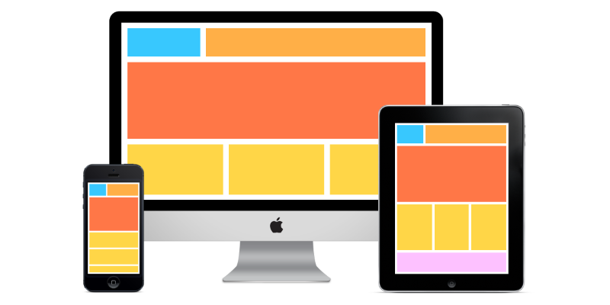
UI/UX

Slide 4
UI/UX
What is a good UI/UX?
- Usable
- Less interaction as much as possible
Color, size, layout, typography, smoothness, ...
- Advanced UI / UX: visual research, micro – interaction, animation, …

Slide 5
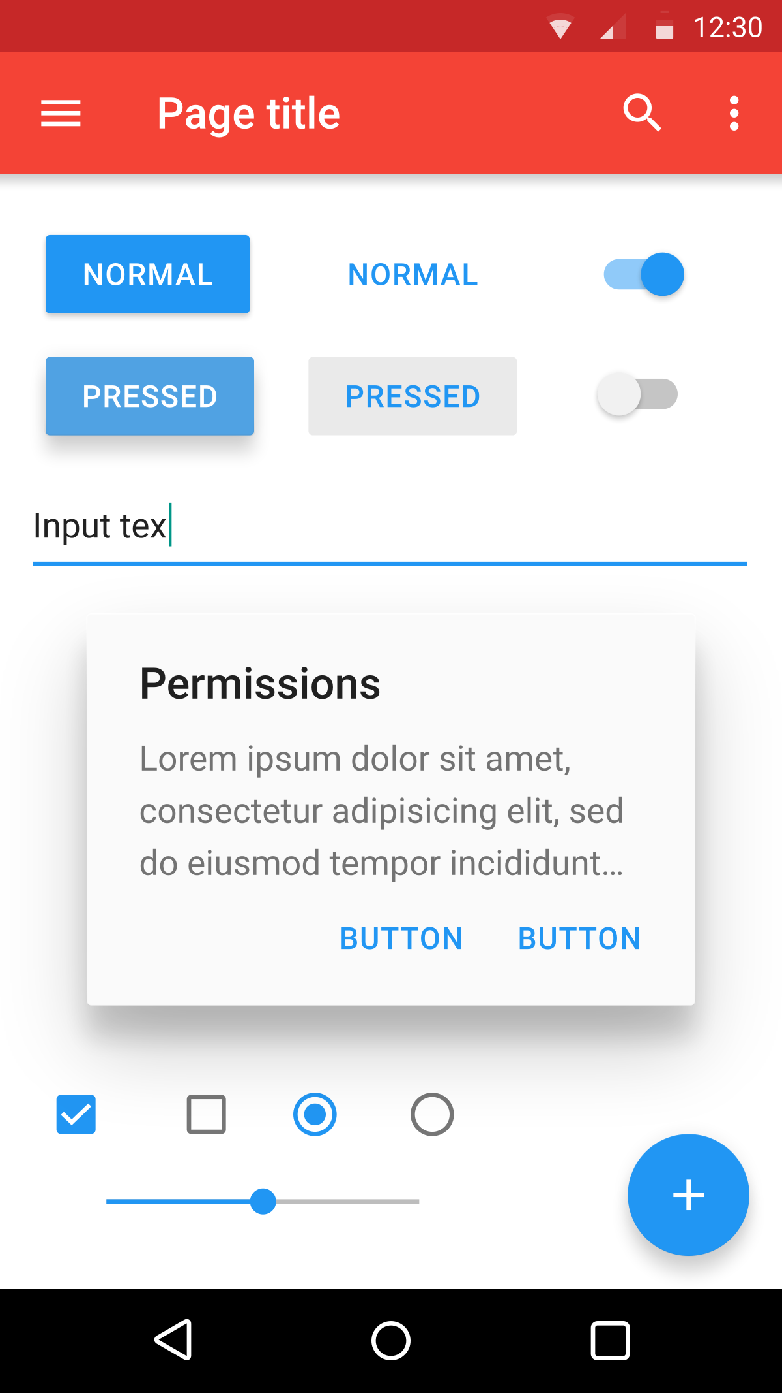
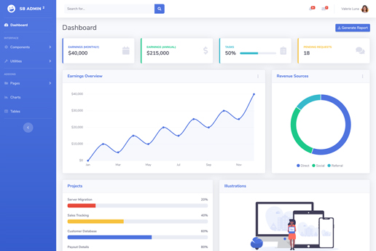
UI/UX
Material design
Some tips:
Use template
Refer similar system
Imagine that you are in user’s position
Bootstrap

Slide 6
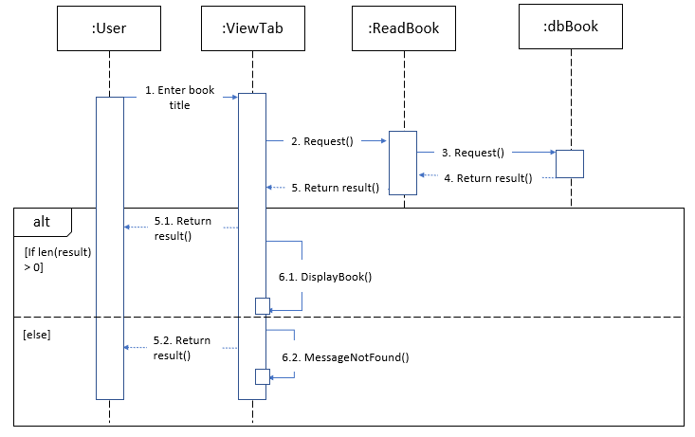
Example
A library is doing the digitization of book management. Readers can view book information online based on book title.

Slide 7
Design UI/UX
First step: research base on
Usecase diagram: How many pages? => Home many usecases?
Sequence diagram: How UI should be? => How does function work?

Slide 8
Design UI/UX
3 pages: Home, SearchResult, DetailBook
Script:
Home: show book by category (newest, most read, …), contain search bar.
SearchResult: show a list of the satisfying books, if the number of books is zero, show a message box.
DetailBook: show information of a specific book

Slide 9
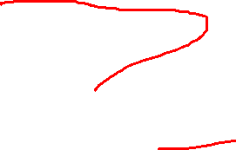
Design UI/UX
Second step: draw user flowchart (how is transition between pages?)
Home
Search
SearchResult
Start
View detail
DetailBook

Slide 10
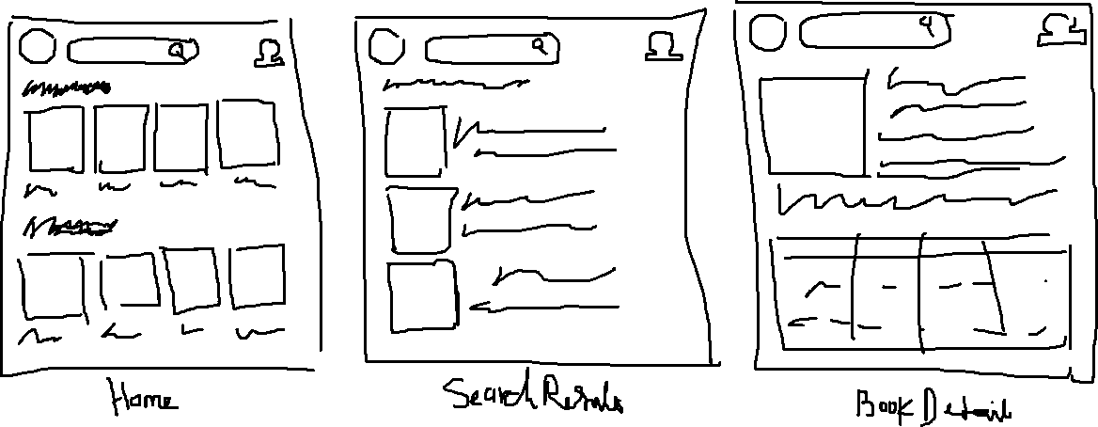
Design UI/UX
Third step: draw sketches

Slide 12
Design UI/UX
Fourth step: draw wireframe / prototype (use Figma)

Slide 13
Homework
Usecase + Sequence diagram
Draw database diagram (submit on folder Diagram) and prototype of your project (replace link in README.md)
Deadline: 2 weeks

Slide 14
Question

